Slide 3

Git Setup

Slide 4
Team
Name | Email Address | Phone
Charles Ballou | Charlesballou@icloud.com
Elizabeth Ho | hoelizabeth09@gmail.com
Cara Monastra | cara.monastra@gmail.com
Jeff Pinegar | jeffpinegar1@gmail.com | 717-982-0516
One Drive Link

Slide 5
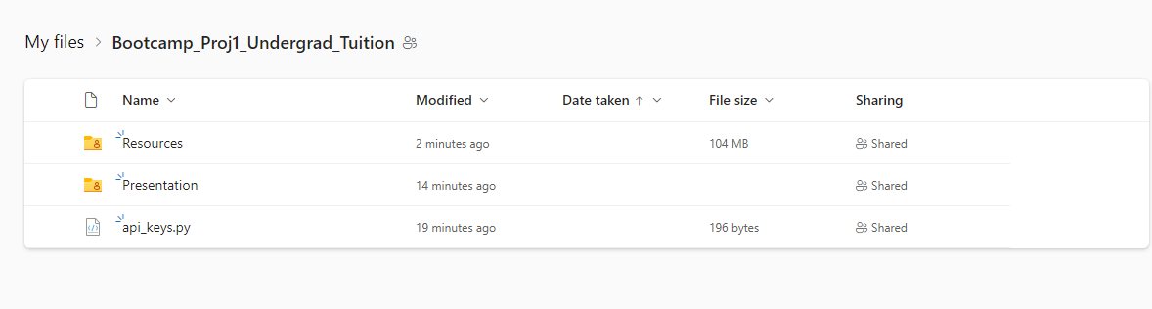
One Drive
https://1drv.ms/u/s!AFvKhos6FFV7gsFc?e=fDHrU7

Slide 7
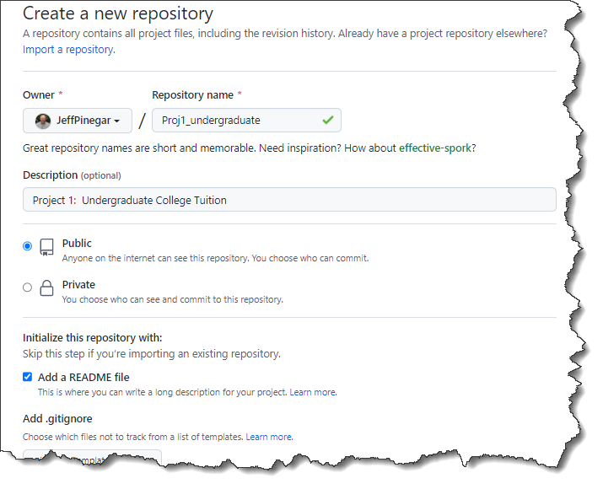

Slide 8
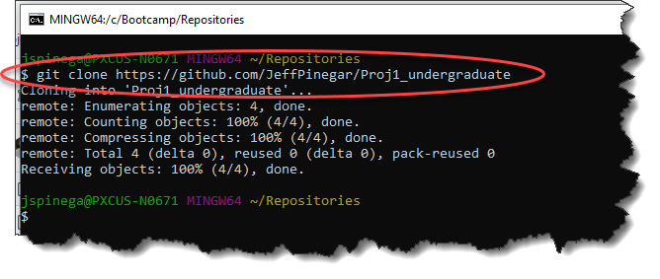
https://github.com/JeffPinegar/Proj1_undergraduate

Slide 9
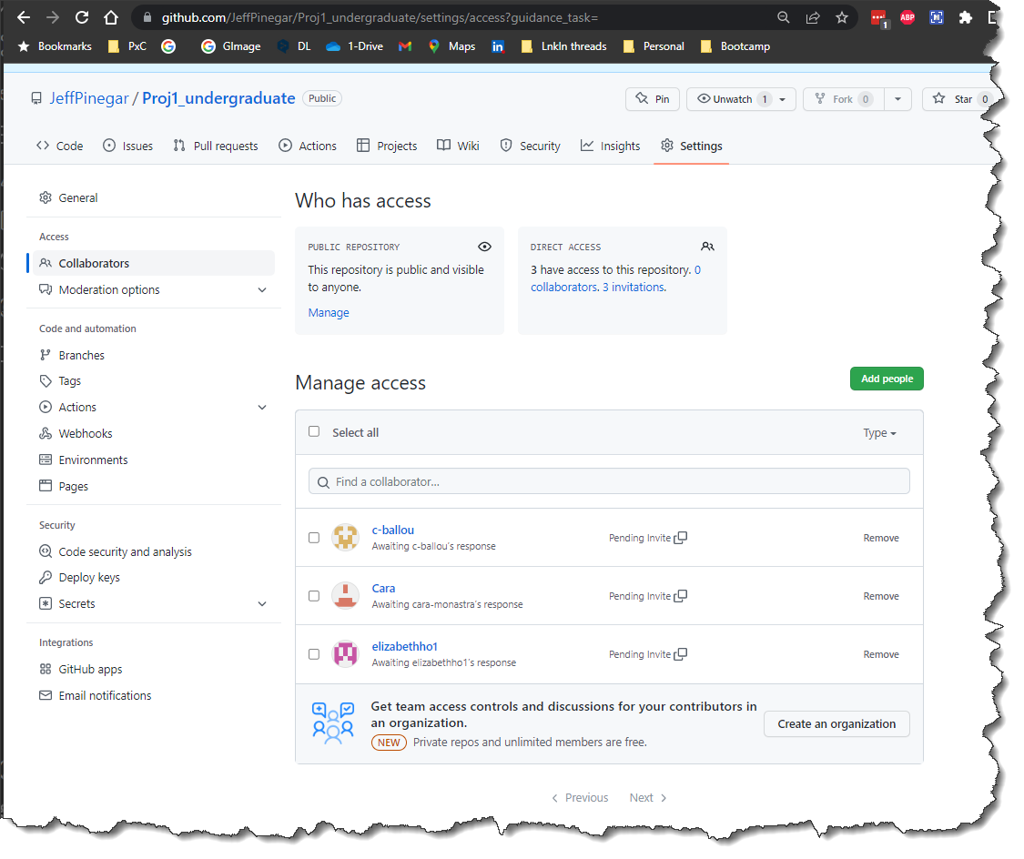

Slide 10
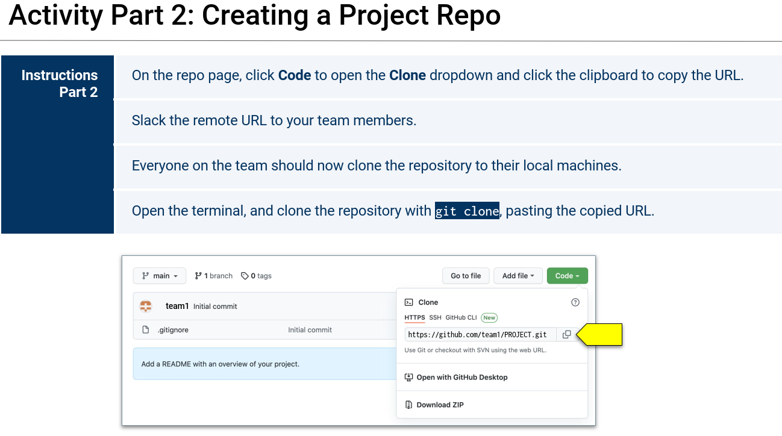

Slide 11
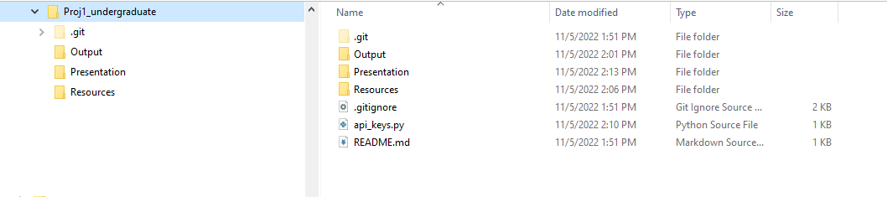
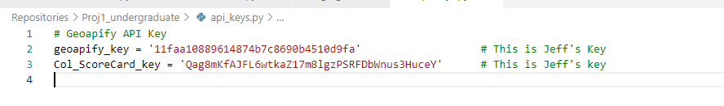
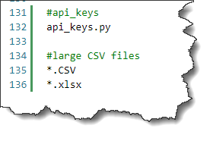
Git Repo Structure

Slide 13
Potential figures
USA map with schools on the map
Color coded by Quartile
Quartile 1 is further color-coded by cost bins
Histogram of college tuition
Box plot of college tuition

Slide 14
Potential Statistics
Comparison of Q1 to Q2, Q3, and Q4
Box plots of:
Student body Size
Admission Rate
Standardized Test Score

Slide 15
“… when an online service is free, you’re not the customer. You’re the product.”
Tim Cook, open letter to customers September 17, 2014
Notes:
A few years ago, users of Internet services began to realize that when an online service is free, you’re not the customer. You’re the product. But at Apple, we believe a great customer experience shouldn’t come at the expense of your privacy.
Our business model is very straightforward: We sell great products. We don’t build a profile based on your email content or web browsing habits to sell to advertisers. We don’t “monetize” the information you store on your iPhone or in iCloud. And we don’t read your email or your messages to get information to market to you. Our software and services are designed to make our devices better. Plain and simple.
Read more: http://www.businessinsider.com/tim-cook-privacy-letter-2014-9#ixzz3Dg0eJ4Ll

